Slide 1
Perlin Noise
Matt Garnes, Kenny Wong, Chirag Khatri

Slide 2
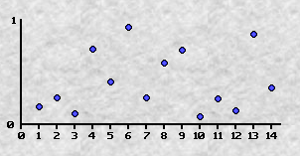
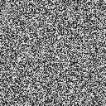
White Noise
Random numbers are generally used in programs to create unpredictability
If we needed something to appear natural random numbers would do a terrible job.
1
2

Slide 3

Perlin Noise
Perlin noise generates coherent noise
Take any two points in the space and the noise value changes smoothly from one point to another

Slide 4

How to Generate Perlin Noise
Generate an array of white noise
For each octave, generate smooth noise
Octaves are essentially how many passes of the algorithm you want to make
Add all of the smooth noise values and normalize your results
1

Slide 5
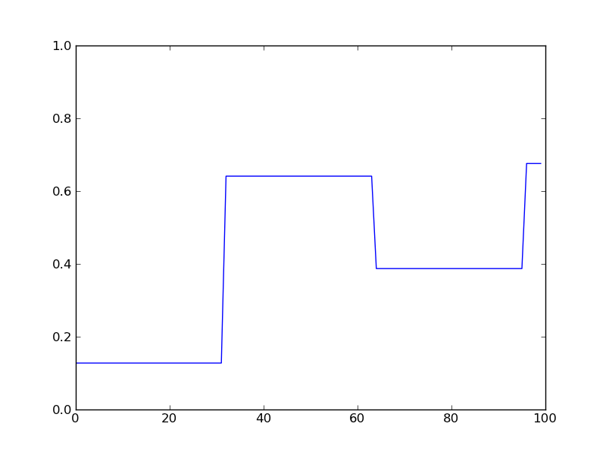
Octave 1

Slide 6
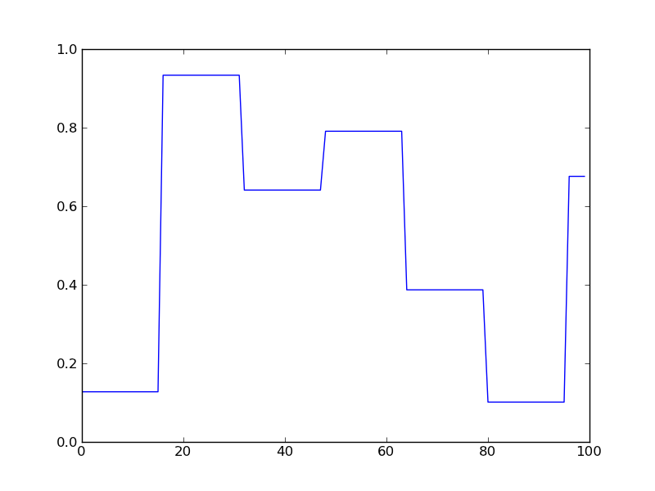
Octave 2

Slide 7
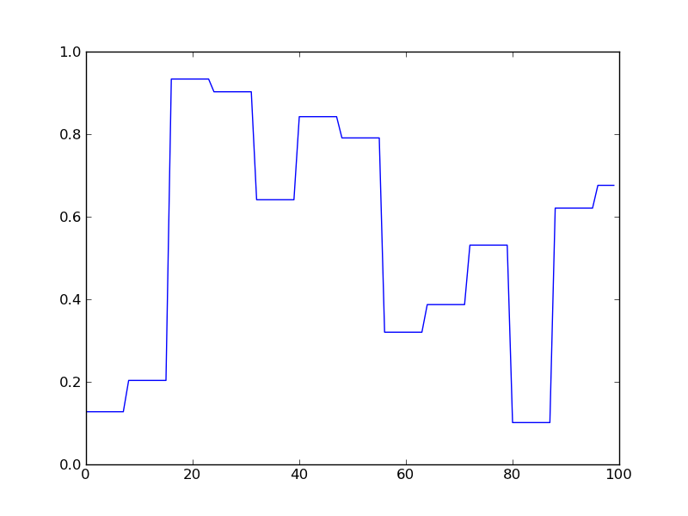
Octave 3

Slide 8
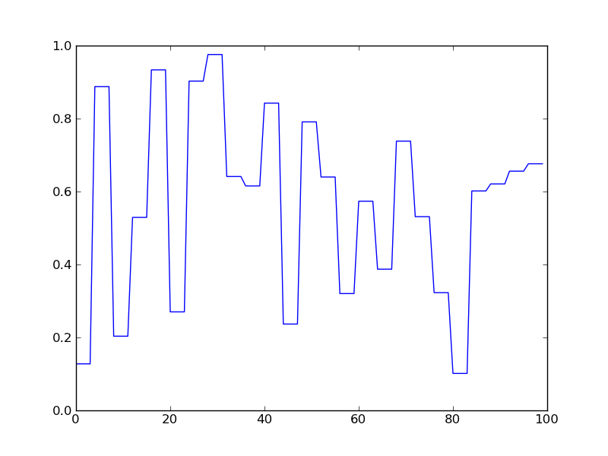
Octave 4

Slide 9
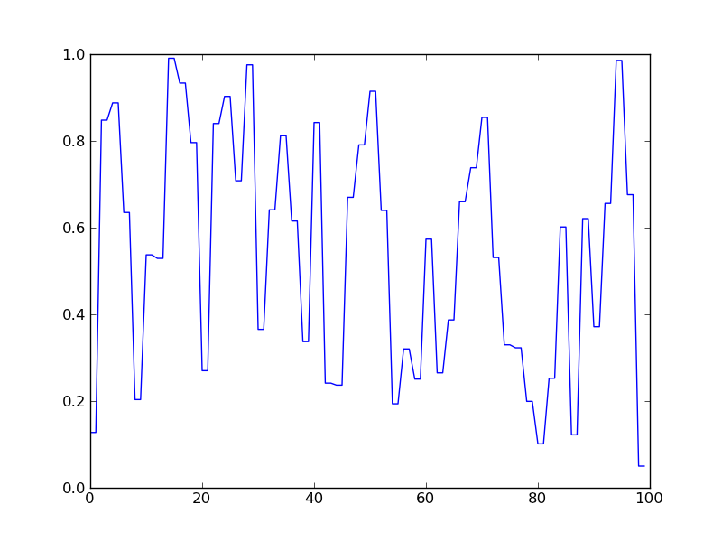
Octave 5

Slide 10
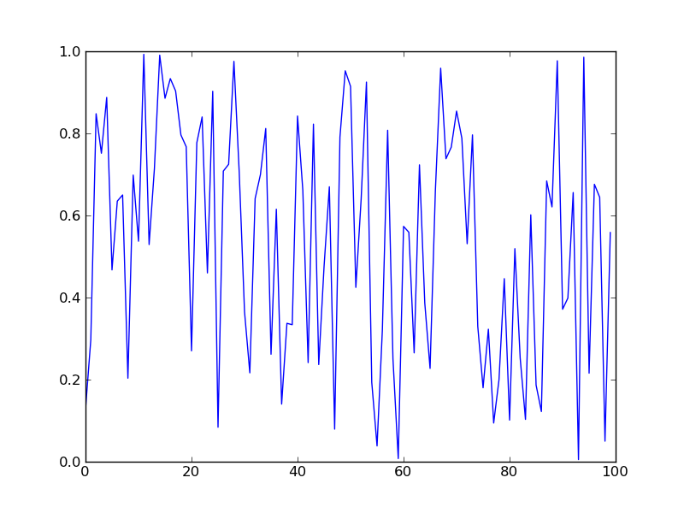
Octave 6

Slide 11
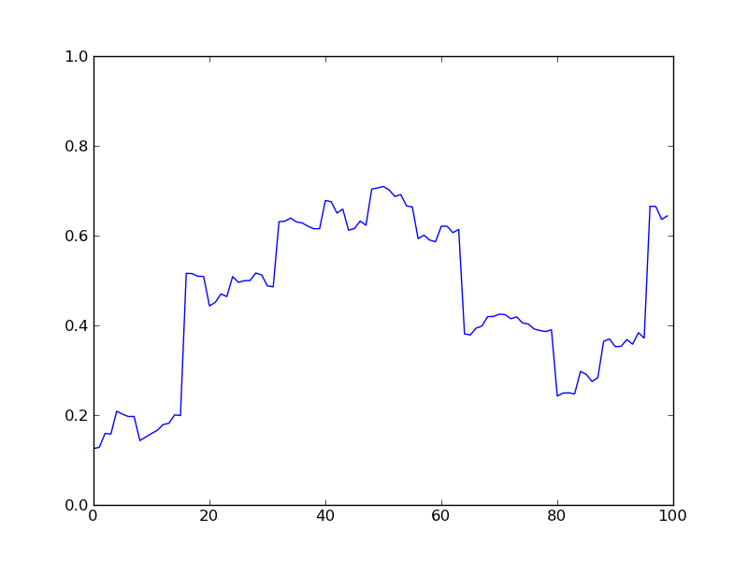
Final Result

Slide 12

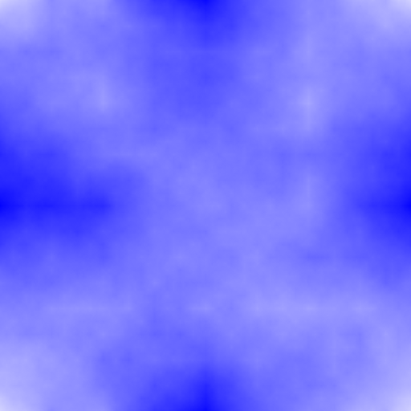
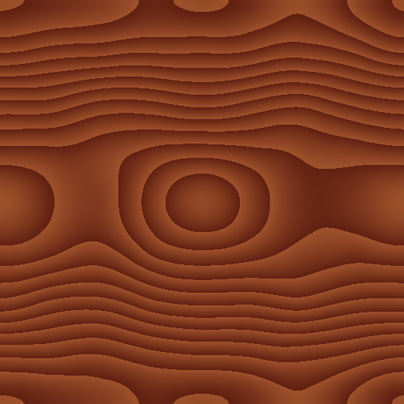
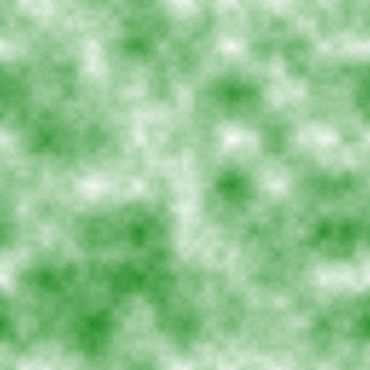
2d Perlin Noise

Slide 13
Applications
1-Dimensional
Control objects so they appear to move naturally
Draw lines so they look like a human drew it
2-Dimensional
Create heightmaps for landscapes
Texture generation
3-Dimensional
3d clouds
Solid textures

Slide 14
Demo Time!

Slide 15
End
References:
http://freespace.virgin.net/hugo.elias/models/m_perlin.htm
http://webstaff.itn.liu.se/~stegu/TNM022-2005/perlinnoiselinks/perlin-noise-math-faq.html

